Slide 1


Lending Club Case Study Analysis
Key Highlights from the analysis

Slide 2
Contents
01
Introduction
05
UNIVARIATE Analysis
02
Analysis Approach
06
BIVARIATE Analysis
03
Data Understanding
07
MULTIVARIATE Analysis
04
Data Preparation
08
Recommendations

Slide 3


Introduction
A consumer finance company which specialises in lending various types of loans to urban customers.
When the company receives a loan application, the company has to make a decision for loan approval based on the applicant’s profile
Two types of risks are associated with the bank’s decision
Not approving the loan results in a loss of business to the company
Approving the loan to an applicant not likely to repay the loan, may lead to a financial loss for the company
Case Brief
To identify patterns which indicate if a person is likely to default
Leveraging the patterns to take decisions that may include denying the loan, reducing the amount of loan, lending (to risky applicants) at a higher interest rate, etc
Objective

Slide 4





Approach
Understand, Clean
& Transform Data
UNIVARIATE
Analysis
BIVARIATE
Analysis
MULTIVARIATE
Analysis
Recommendations
Awareness about key columns/features
Identify & treat null values, duplicates
Identify & drop columns not relevant or useful
Missing Values, Outliers Treatment
Standardize, Manipulate, Derive to aid analysis
Binning/Bucketing
Count Plot, Box Plot
Loans Vs Grades
Defaulter Vs Loan Purpose
Defaulters Vs Loan Amount Range
Defaulters Vs Credit Lines
Defaulters Vs Interest Range
Defaulters Vs Income Range
Bar Plot, Box Plot, Scatter Plot
Analyzing Defaulters for
Term, Purpose
Income Range, Purpose
Loan Amount, Term
Annual Income, Purpose
Purpose, Installment
Loan Amount, Interest
Analyzing Loan Status for
Term, Interest Rate
Interest Rate, Purpose
Issue Month, Interest Rate
Correlation Heatmap
Analysis to check if there is relationship or correlation among 2 or more numeric variables
Key inferences from the data analysis
Summary of key recommendations for the company (Lending Club)

Slide 5
Data Understanding
After the basic clean up (nulls, duplicates), a comprehensive assessment done to identify other columns that need to be removed. Snapshot of the assessment below
Sr # | Column Names | Remarks
1 | id, member_id | Not required
2 | acc_now_delinq | Empty
3 | pymnt_plan, initial_list_status | fixed value as n & f respectively for all
4 | url, desc, emp_title | Not useful for analysis
5 | title | Too many distinct values, not useful
6 | zip_code | Full info not available
7 | mths_since_last_delinq | Only partial info available
8 | mths_since_last_record | Approx 10% only has values
9 | revol_bal, out_prncp, out_prncp_inv, total_pymnt, total_pymnt_inv | Not useful for defaulter analysis
10 | total_rec_prncp, total_rec_int, total_rec_late_fee, recoveries, collection_recovery_fee | Not useful for defaulter analysis
11 | last_pymnt_d, last_credit_pull_d, last_pymnt_amnt, next_pymnt_d, chargeoff_within_12_mths | Not useful for defaulter analysis
12 | collections_12_mths_ex_med, policy code, acc_now_delinq, delinq_amnt, tax_liens , application_type | Only 1 value in the columns
13 | addr_state | State info will not help in identifying likely defaulters

Slide 6
Data Preparation To Aid Analysis
Data Standardization
Data Format Conversion
Data Binning / Bucketing
Data Derivation
Data Visualization

Slide 7
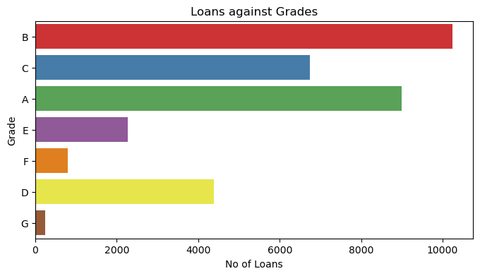

Univariate Data Analysis
Loans against Grade
Key Inference
Large number of loans are taken with higher grades

Slide 8
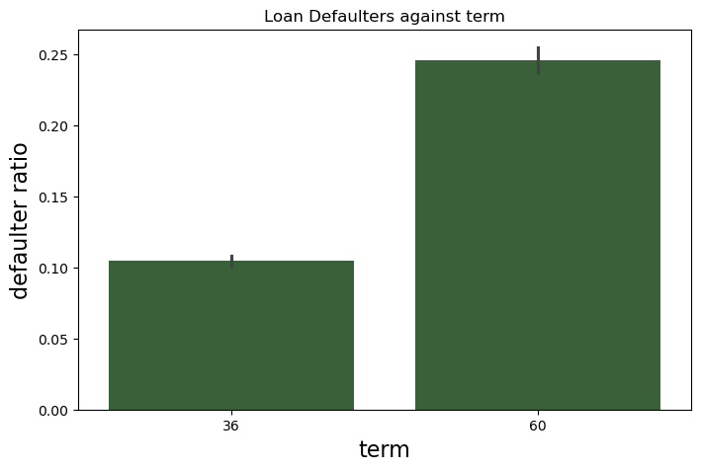
Univariate Data Analysis
Defaulters against Loan Term
Key Inference
Default Ratio increases with Loan Term

Slide 9
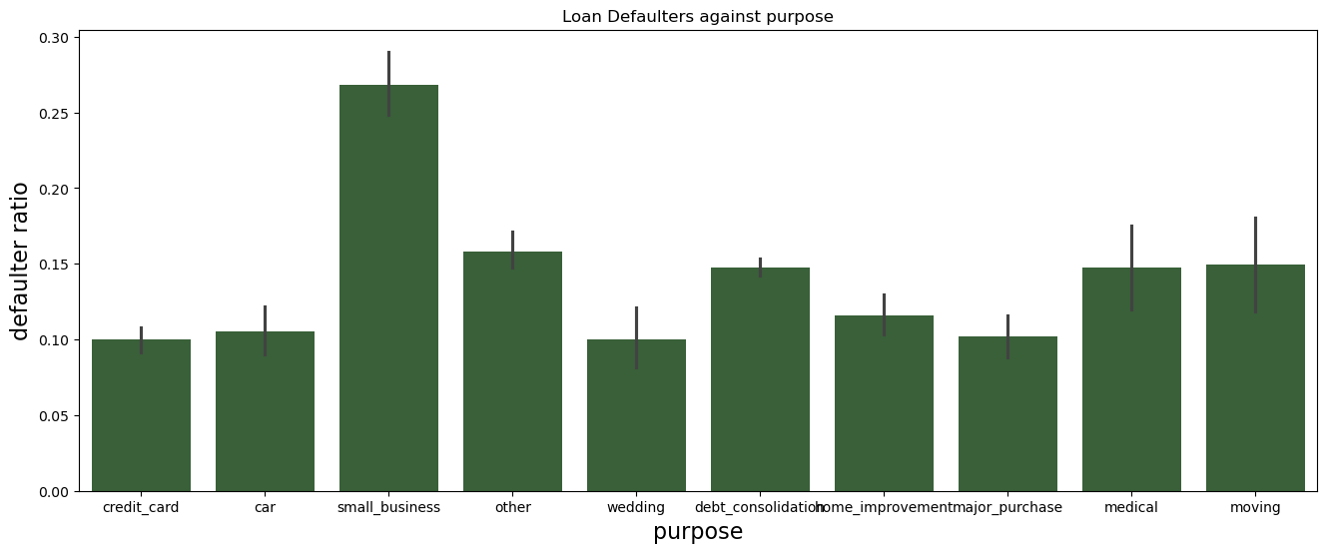
Univariate Data Analysis
Loan Defaulters against Loan Purpose
Default Ratio is depending on purpose of the loan and small business has highest number
Key Inference

Slide 10
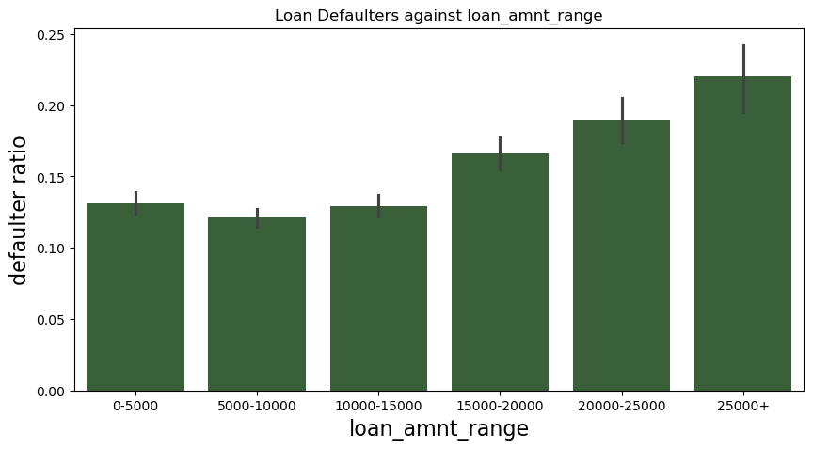
Univariate Data Analysis
Loan Defaulters against Loan Amount
Default Ratio is increasing with loan amount range
Key Inference

Slide 11
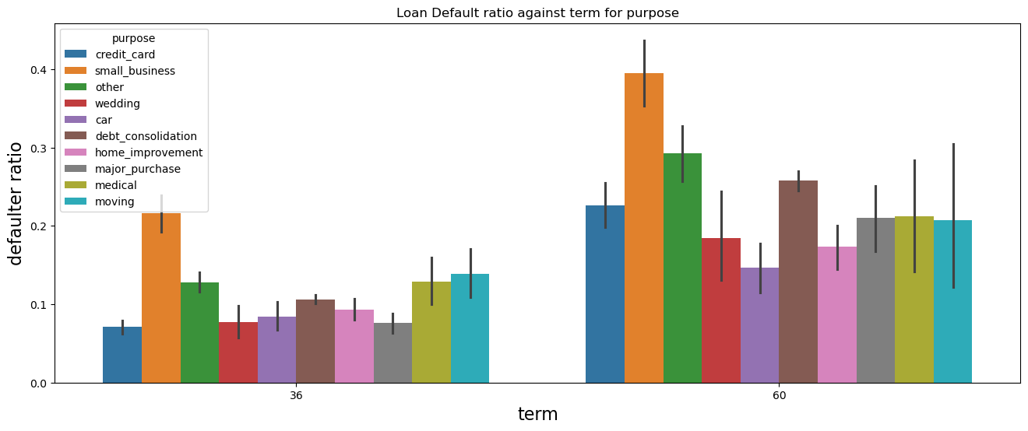
Bivariate Data Analysis
Loan Default Ratio against Loan Amount Range and Term
Key Inference
Chart shows a strong correlation - default ratio increases against term for purpose

Slide 12
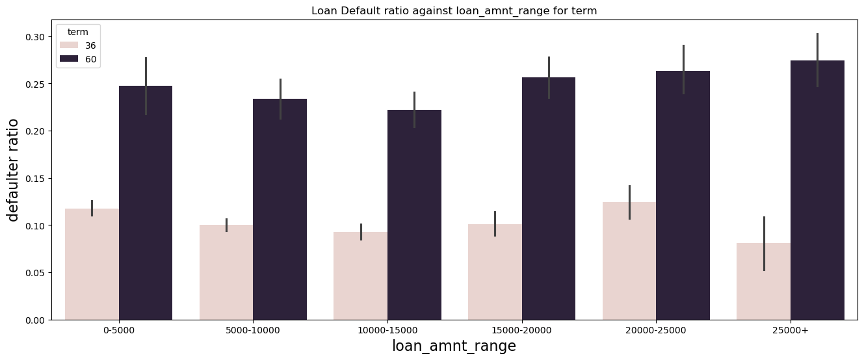
Bivariate Data Analysis
Loan Default Ratio against term and purpose
Key Inference
Default ratio increases with term for every loan amount range

Slide 13
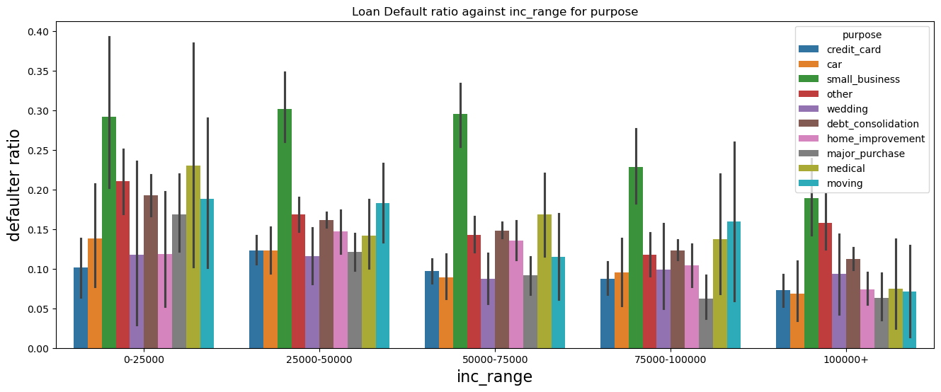
Bivariate Data Analysis
Loan Default Ratio against term and purpose
Key Inference
Default ratio increases with term for every loan amount range

Slide 14
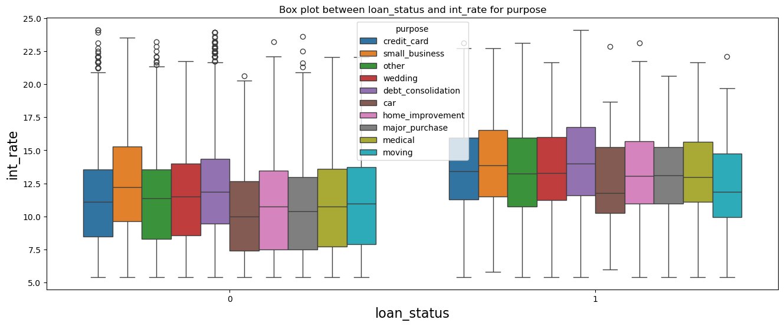
Bivariate Data Analysis
Loan Status against interest rate and purpose
Key Inference
Interest rate high for defaulting cases for every loan purpose
(Note: 1 refers to defaulters and 0 refers to fully paid)

Slide 15
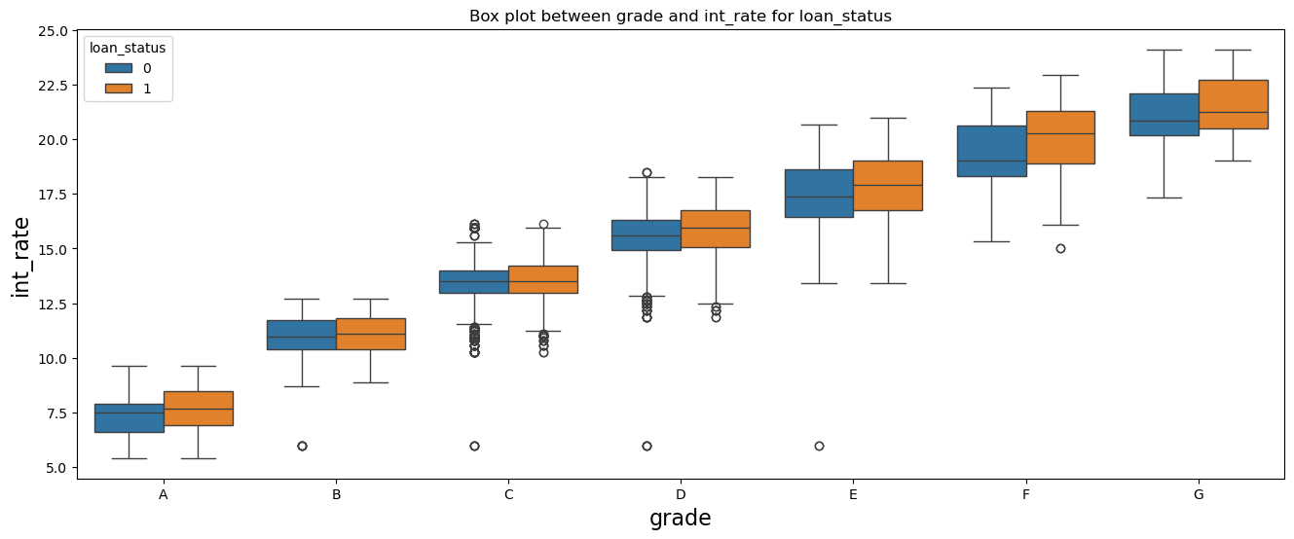
Bivariate Data Analysis
Grade against interest rate for each loan status
Interest rate increasing with grades
some of the defaulters are having their median somewhat near to 75% quantile of interest rate of those fully paid (Note: 1 refers to defaulters and 0 refers to fully paid)
Key Inference

Slide 16
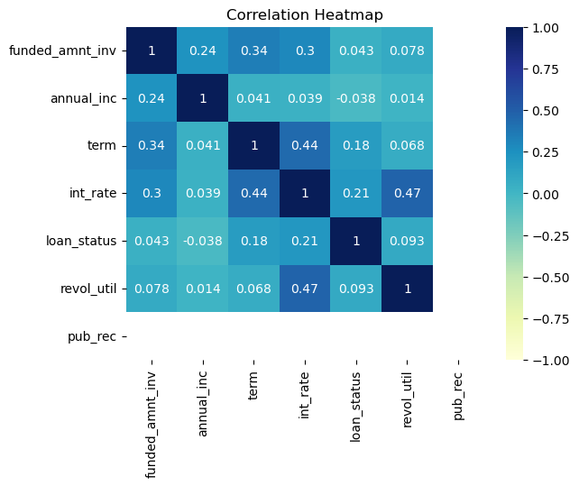
Multivariate Analysis
To check if there is correlation or relationship among numeric variables
Key Inference
From the adjacent heatmap, it is very clear that there no strong correlation amongst the plotted variables

Slide 17

Recommendations
Conclusion
After analysing all the relevant & related parameters available in the dataset, we have come to an informed opinion on driving parameters, which can help the company in deciding whether a loan is to be sanctioned or denied to the customer.
The best driving parameters are - term, grade, purpose, revol_util, int_rate, installment, annual_inc, funded_amnt_inv

Slide 18
Thank YOU
Amit
Mukund
PG Program in Machine Learning & Artificial Intelligence (C71)

